Slide 1
IPV 6 (Internet protocol version 6)
Md. Foysal Mahmud.
Roll: 14CSE028
Department of Computer Science & Engineering,
University of Barisal.

Slide 2
Introduction:
Internet Protocol version 6 (IPv6) is the latest revision of the Internet Protocol(IP).
Story began in the early nineties when discovered that the address space available in IPv4 was vanishing quite rapidly.
IPv6 was developed by the Internet Engineering Task Force (IETF).Main architects of this new protocol were Steven Deering and Robert Hinden.
It provides an identification and location system for computers on networks and routes traffic across the internet.

Slide 3
Why we need IP address:
Internet Protocol (IP) addresses are the unique numbers assigned to every computer or device that is connected to the internet.
It is a logical address in the network layer of TCP/IP protocol. This enables a computer to communicate with another computer somewhere else in the world.
It is used to locate Web sites, Servers & other devices like PC, Smart Phone, Laptops.

Slide 4
Review of IPV4:
It was developed in the early 1980 & served the global Internet community for more than 3 decades.
IPv4 has more than 4 billion unique IP addresses but nearly 3.7 billion IPv4 address are used by ordinary internet access devices.
The others are used for special protocols like IP Multicasting.
Mainly, due to the need for more IP addresses, IPv6 is replacing IPv4 address.

Slide 5
Why another version:
Scarcity of IPv4 addresses.
Security Related Issues.
Address configuration related issues.
Quality of service (QoS)
Internet routing table very big.
Broadcast.

Slide 6
IPv6 Addresses:
An IPv6 is a 128-bit address that uniquely and universally defines the connection of a device to the internet.
[ Two device on the internet can never have the same address at the same time]

Slide 7
Notations:
Dotted-Decimal: It is used for IPv4 compatibility.
[221.14.65.11.105.45.170.34.12.234.18.0.14.0.115.255]{16 bytes}
Colon Hexadecimal: It is used to make the address more readable. In this notation, the 128 bits are divided into 8 sections, each of 2 bytes in length. [Two bytes in hexadecimal required 4 Hexadecimal digits]
FDEC : BA9B : 7654 : 3210 : ADBF : BBFF : 2422 : FFFF

Slide 8
Abbreviation:
It is a technique to reduce the length of IPv6 address. It is done by omitting / removing the leading zeros of a section.
[Only the leading zeros can be dropped]
It is also called zero compression.
FDEC : 0074 : 0000 : 0000 : 0000 : B0FF : 0000 : FFFO
FDEC : 74 : 0 : 0 : 0 : B0FF : 0 : FFFO
GAP
FDEC : 74 : : B0FF : 0 : FFFO

Slide 9
Types of Address space in IPv6:
Unicast Addresses: It defines single interface or computer. The packet sent to a unicast address will be routed to the intended PC or recipient.
Multicast Addresses: These are used to define a group of computers / hosts. In this, each member of the group receives the packet.
Anycast Addresses: Defines group of nodes or computers that all share a single address. A packet with anycast address is delivered to only one member of the group which is the most reachable one.

Slide 10
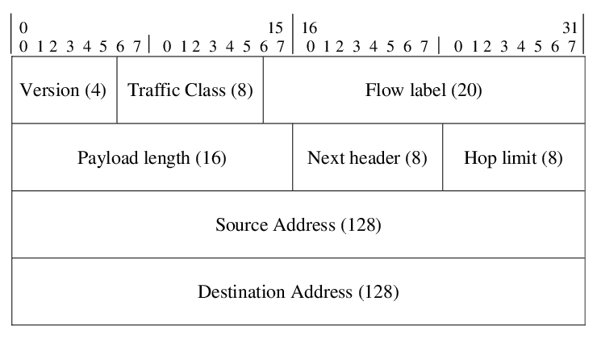
IPv6 Packet Format:

Slide 11
Changes in IPv6:
Larger address space
Better Header format
New option
Allowance for extension
Support for Resource Allocation
Support for More security

Slide 12
Transition from IPv4 to IPv6:
Complete transition from IPv4 to IPv6 might not be possible because IPv6 is not backward compatible. This results in a situation where either a site is on IPv6 or it is not. It is unlike implementation of other new technologies where the newer one is backward compatible so the older system can still work with the newer version without any additional changes.
To overcome this short-coming, we have a few technologies that can be used to ensure slow and smooth transition from IPv4 to IPv6.

Slide 13
Transition from IPv4 to IPv6:
Dual Stack Routers:
A router can be installed with both IPv4 and IPv6 addresses configured on its interfaces pointing to the network of relevant IP scheme.

Slide 14
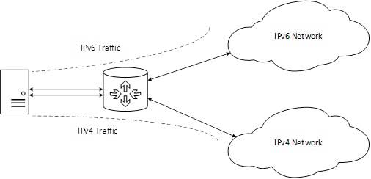
In the above diagram, a server having IPv4 as well as IPv6 address configured for it can now speak with all the hosts on both the IPv4 as well as the IPv6 networks with the help of a Dual Stack Router. The Dual Stack Router, can communicate with both the networks. It provides a medium for the hosts to access a server without changing their respective IP versions.

Slide 15
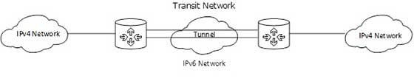
Transition from IPv4 to IPv6:
Tunneling:
In a scenario where different IP versions exist on intermediate path or transit networks, tunneling provides a better solution where user’s data can pass through a non-supported IP version.
The above diagram depicts how two remote IPv4 networks can communicate via a Tunnel, where the transit network was on IPv6. Vice versa is also possible where the transit network is on IPv6 and the remote sites that intend to communicate are on IPv4.

Slide 16
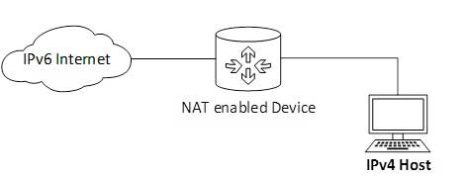
Transition from IPv4 to IPv6:
NAT Protocol Translation:
This is another important method of transition to IPv6 by means of a NAT-PT (Network Address Translation – Protocol Translation) enabled device. With the help of a NAT-PT device, actual can take place happens between IPv4 and IPv6 packets and vice versa. See the diagram below:

Slide 17
A host with IPv4 address sends a request to an IPv6 enabled server on Internet that does not understand IPv4 address. In this scenario, the NAT-PT device can help them communicate. When the IPv4 host sends a request packet to the IPv6 server, the NAT-PT device/router strips down the IPv4 packet, removes IPv4 header, and adds IPv6 header and passes it through the Internet. When a response from the IPv6 server comes for the IPv4 host, the router does vice versa.

Slide 18


